Slide 1


Slide 2
9.4 Confidence intervals for the mean of a small sample
In a hypothesis test, we are interested in finding the critical region for the test. A confidence interval can be thought of as the acceptance region instead.
For confidence intervals, it is important to note the following concepts:
A confidence interval is created from a sample taken.
If another sample is taken, then a different confidence interval will be found.
The population mean, although unknown, is fixed and so we assess whether the confidence interval contains the population under different confidence levels.

Slide 3
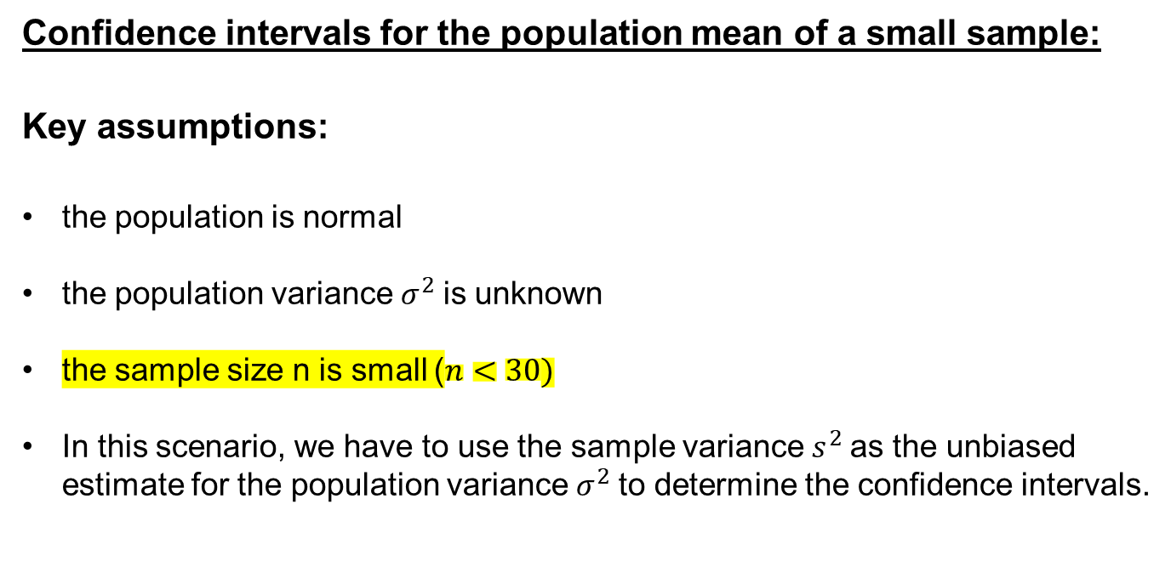
Confidence intervals for the population mean of a small sample:
Key assumptions:
the population is normal
the population variance $σ^{2}$is unknown
the sample size n is small ($n<30)$
In this scenario, we have to use the sample variance $s^{2}$as the unbiased estimate for the population variance $σ^{2}$to determine the confidence intervals.

Slide 4
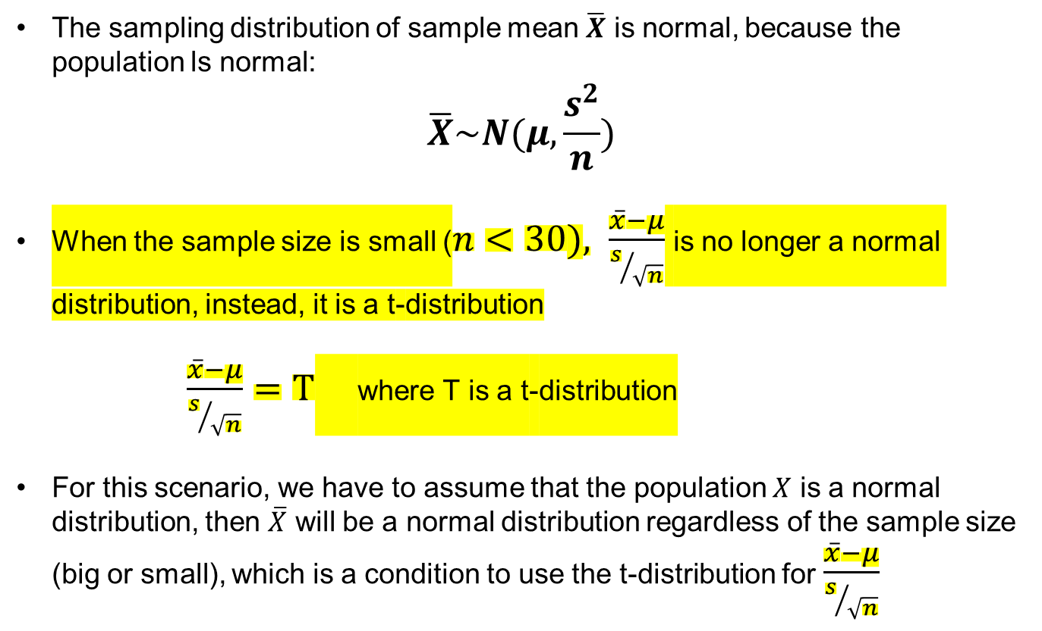
The sampling distribution of sample mean $\overline{X}$ is normal, because the population ls normal:
$$\overline{X}\sim N(μ,\frac{s^{2}}{n})$$
When the sample size is small ($n<30), \frac{\overline{x}−μ}{s/{\sqrt{n}}}$ is no longer a normal distribution, instead, it is a t-distribution
$\frac{\overline{x}−μ}{s/{\sqrt{n}}}=T$ where T is a t-distribution
For this scenario, we have to assume that the population $X$ is a normal distribution, then $\overline{X}$ will be a normal distribution regardless of the sample size (big or small), which is a condition to use the t-distribution for $\frac{\overline{x}−μ}{s/{\sqrt{n}}}$

Slide 5
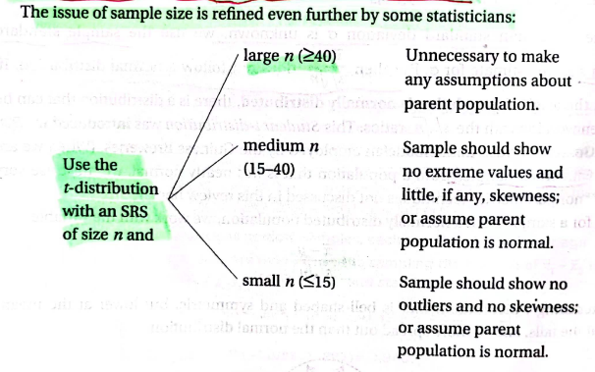
SRS-Single Random Sample

Slide 6


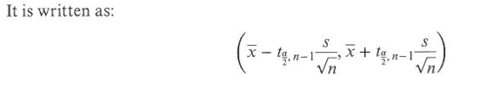

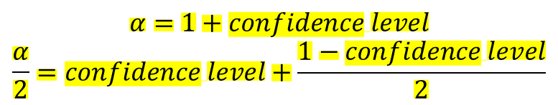
$$n<30$$
$$α=1+confidence level$$
$$\frac{α}{2}=confidence level+\frac{1−confidence level}{2}$$

Slide 7
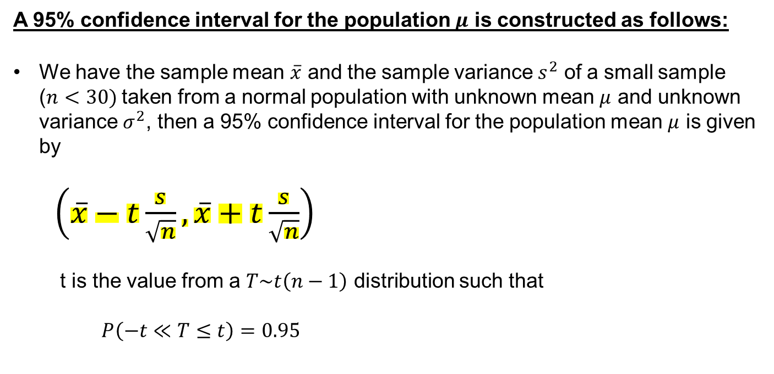
A 95% confidence interval for the population $μ$ is constructed as follows:
We have the sample mean $\overline{x}$ and the sample variance $s^{2}$ of a small sample ($n<30)$taken from a normal population with unknown mean $μ$ and unknown variance $σ^{2}$, then a 95% confidence interval for the population mean $μ$ is given by
$\left(\overline{x}−t\frac{s}{\sqrt{n}}, \overline{x}+t\frac{s}{\sqrt{n}}\right)$
t is the value from a $T\sim t\left(n−1\right)$ distribution such that
$P\left(−t≪T≤t\right)=0.95$

Slide 8
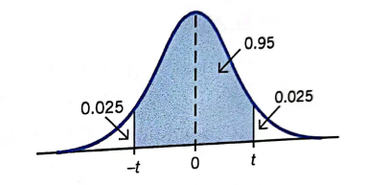
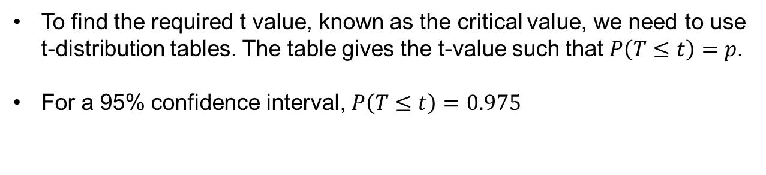
To find the required t value, known as the critical value, we need to use t-distribution tables. The table gives the t-value such that $P\left(T≤t\right)=p$.
For a 95% confidence interval, $P\left(T≤t\right)=0.975$

Slide 9
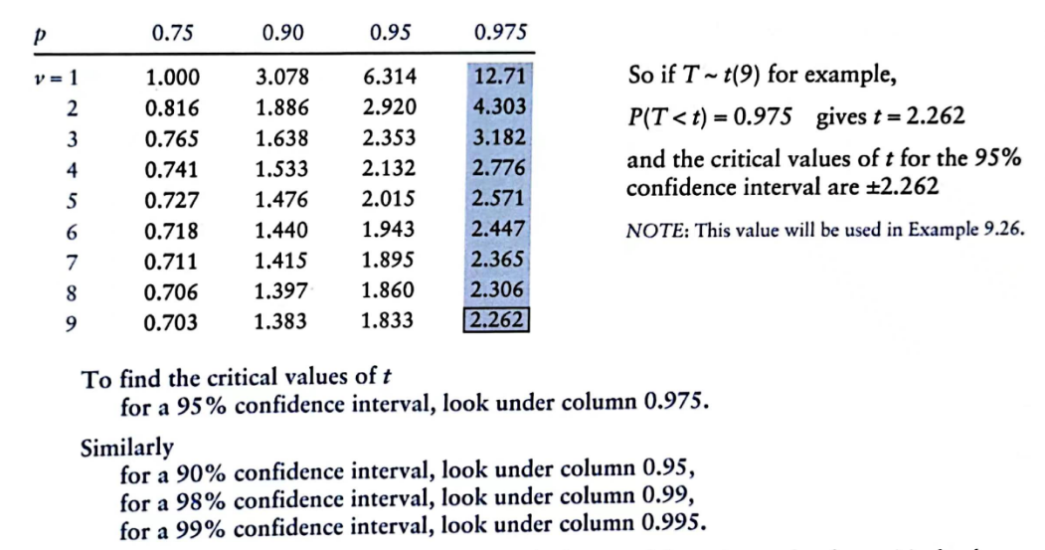

Slide 10
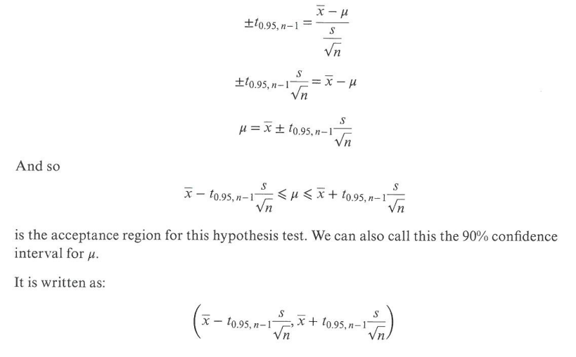
A 90% confidence interval for the population $μ$ is constructed as follows:

Slide 11
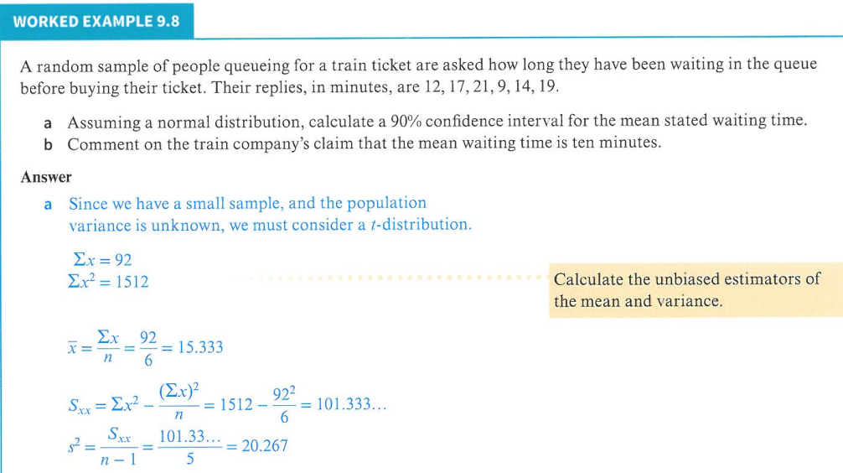

$$n=6<30$$

Slide 12
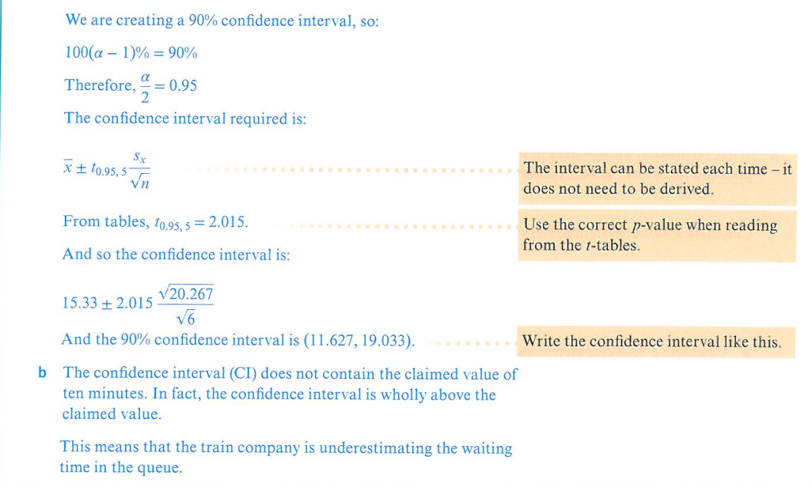
$α=1+0.90=1.90,$degrees of freedom$=6−1=5$

Slide 13
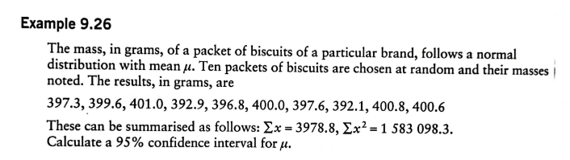

$$n=10<30$$

Slide 14
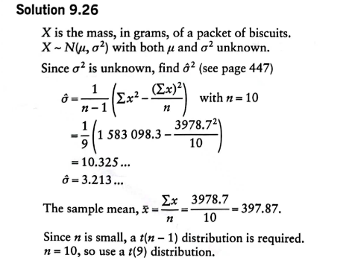

Slide 15
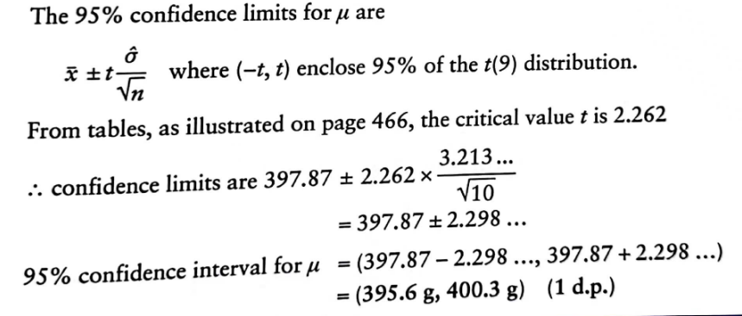

Slide 16
Practice Time!

Slide 17
Exercise 9D
In class 1,2,3,4
Homework 5,6,7,8

Slide 18
The End
Thank You

